Slide 1

Module 6 – Video 5
Flat fee pricing
Professor Nico Voigtländer
Management 405: Module 6

Slide 2
OUTLINE of module 6
Simple vs. complex pricing
Direct price discrimination
  Perfect price discrimination (first degree)
  Segment pricing (third degree)
Indirect price discrimination (second degree)
    Versioning
  Coupons
Advanced pricing strategies
  Flat fee pricing
  Two-part tariff
  Block pricing

Slide 3
Context
So far: We had different consumers with different demand curves (marginal personal value)
  Extract surplus via direct/indirect price discrimination
Now: Consumers have identical demand curves, but each of them purchases multiple units of the product
  We will focus on a “representative consumer”

Slide 4
Advanced Pricing
How to extract consumer surplus from a given consumer who is prepared to buy multiple units
Diminishing marginal personal value comes into play
We will study three variants of advanced pricing
  All-or-none offers (flat fee)
  Two-part tariffs (flat fee + usage fee)
  Block pricing

Slide 5
Example: Netflix flat fee (assume MC=0)
P
Yellow area = total value of unlimited movies for the consumer = maximum fee Netflix can charge
Area = (16x2)/2 = 16
With a $16 flat flee for unlimited access, Netflix can attain $16 revenue – twice as much as under simple pricing (see Module 6 – Video 1)
The consumer will watch 16 movies under this fixed-fee-unlimited-access system
Consumer surplus in this case = 0
Note: only makes sense when MC=0
$2
P=2-Q/8
Revenues
=$16
D
16
Movies
Notes:
With MC=0, people buy to where the value is zero. You want to capture the entire area under the demand curve. How much does the consumer pay? For a flat fee of $400, he would be just willing to purchase the bundle of 20 units. The company doubles their contribution and extracts all the surplus.
Equivalent pricing schemes: A sliding scale discount pricing scheme amounts to the same thing – charge lower and lower amounts for each subsequent unit sold. Here you march the consumer down the demand curve and you charge successively lower prices that allow you to capture all the surplus. The quantity discounts come from the seller’s realization that the buyer has a downward sloping demand curve.

Slide 6
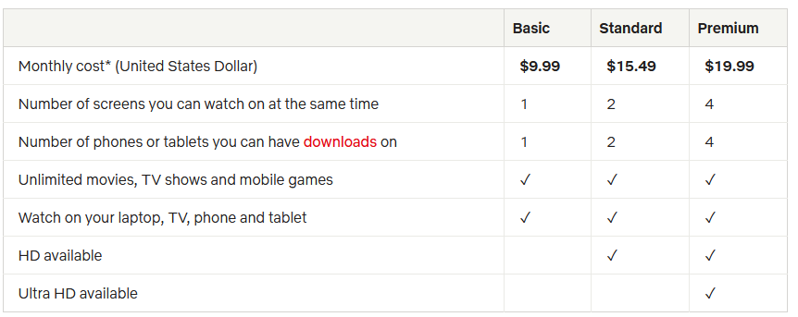
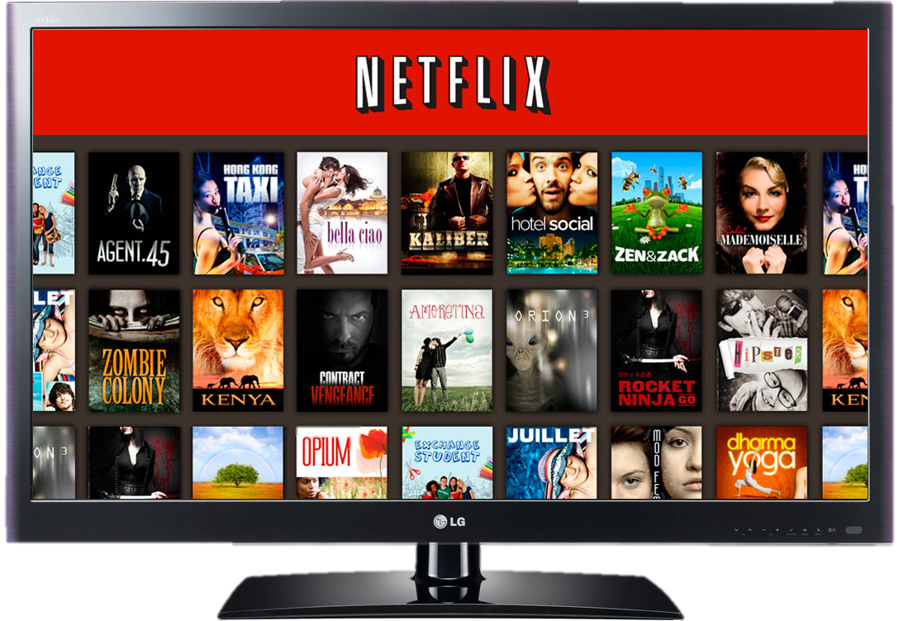
Netflix pricing strategy
  Note that this pricing strategy is a mix of flat fee and versioning
Notes:
This chart represent the pricing strategy of Netflix, as an example of versioning. They have three plans, from basic to premium. The chart on the right represents the change in strategy that Netflix followed over time
This is a very good video on increase in price in 2017, where they also discuss previous price increases and the backlash associated with them
https://finance.yahoo.com/news/netflix-price-hikes-wont-hurt-subscriber-growth-211526185.html

Slide 7
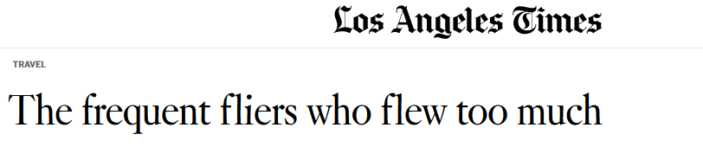
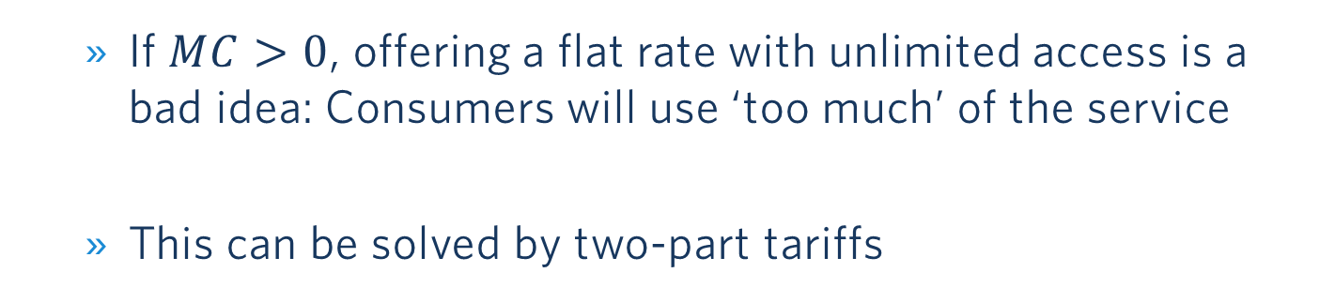
What can Go Wrong with Flat Rates…
  If $MC>0$, offering a flat rate with unlimited access is a bad idea: Consumers will use ‘too much’ of the service
  This can be solved by two-part tariffs

